Slide 1
Session 1- Practical Statistics via python & introduction to numpy
Instructor: Rasha Sadeq Abdin

Slide 2
Agenda
Practical Statistics via python for Data Scientists
Introduction to colab
Introduction to Numpy

Slide 3
Why to study statistics as Data Scientists
Data scientists use statistics to gather, review, analyze, and draw conclusions from data, as well as apply quantified mathematical models to appropriate variables.
Notes:
For instance when you get data you want to clean from null values, outliers. Even if it is cleaned, you want to understand the data on hand. Visualize it, and try to understand hidden patterns. In later stages you will be able build algorithoms based on your understading. Statistcal understanding can be considered as the base of your pyramid in any AI branch

Slide 4
Population vs Sample dataset
A population is the entire group that you want to draw conclusions about.
A sample is the specific group that you will collect data from. The size of the sample is always less than the total size of the population.
Notes:
Session1

Slide 5
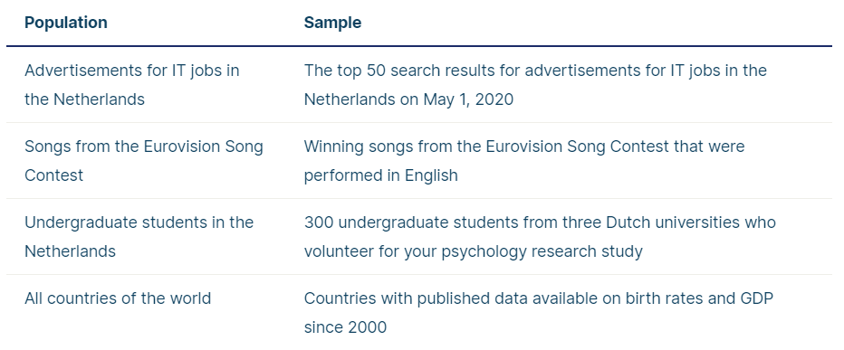
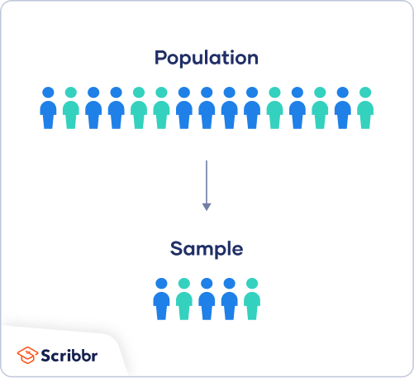
Population vs Sample dataset

Slide 6
Reasons for sampling
Necessity: Sometimes it’s simply not possible to study the whole population due to its size or inaccessibility.
Practicality: It’s easier and more efficient to collect data from a sample.
Cost-effectiveness: There are fewer participant, laboratory, equipment, and researcher costs involved.
Manageability: Storing and running statistical analyses on smaller datasets is easier and reliable

Slide 7
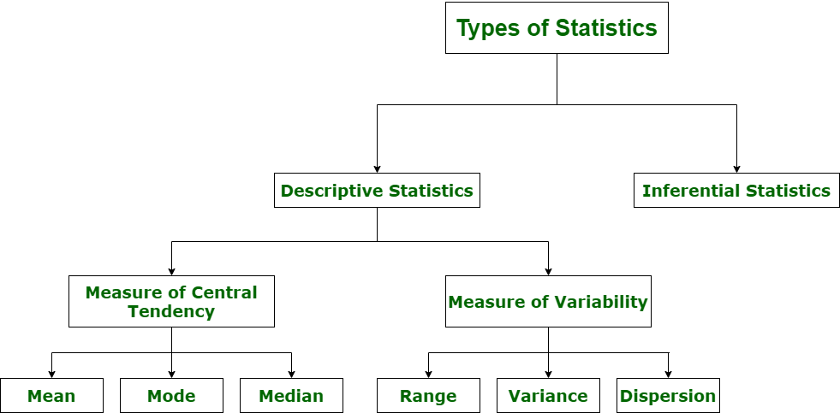
Types of statistics in data science
A way of making inferences about populations based on samples
Describe, show, and summarize the basic features of a dataset found in a given study, presented in a summary

Slide 8
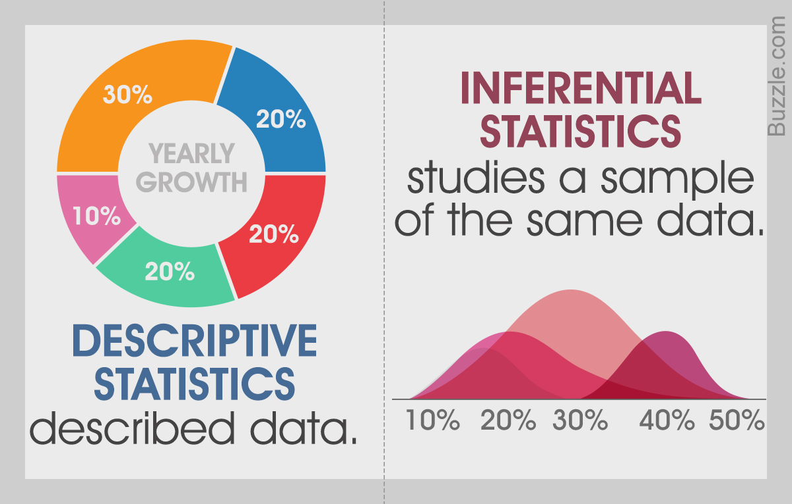
Types of statistics in data science

Slide 9
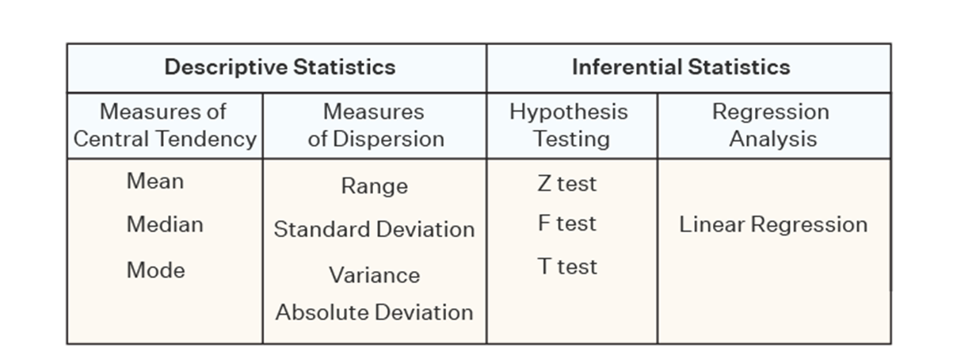
Types of statistics in data science

Slide 10
Types of statistics in data science
Descriptive Statistics →
Describe, show, and summarize the basic features of a dataset found in a given study, presented in a summary that describes the data sample and its measurements. It helps analysts to understand the data better

Slide 11
Types of statistics in data science
Inferential statistics →
A way of making inferences about populations based on samples. Given information about a subset of examples, how do we draw conclusions about the full set

Slide 12
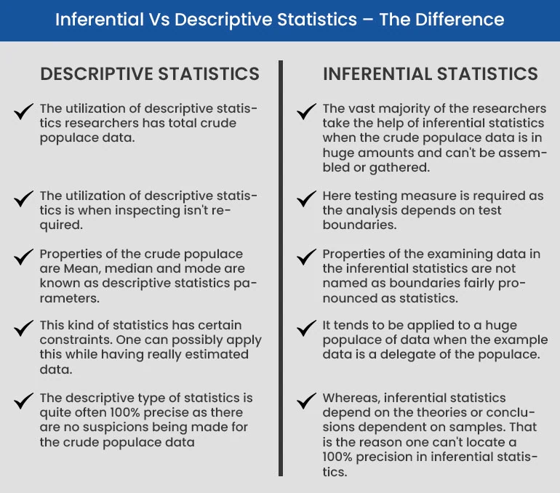
Types of statistics in data science

Slide 13
Types of statistics in data science

Slide 14
Measure of central tendency
Mean: the sum of all values divided by the total number of values
Median: the middle number in an ordered dataset.
Mode: the most frequent value.

Slide 15
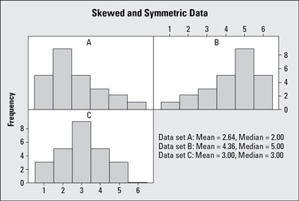
Skew and Symmetry in a Statistical Histogram in relation to the measure of central tendency
Notes:
https://mega.nz/folder/wswGEIhb#tsqUggTZyfy5HyRWUkV9sg/folder/dkAVEYjA Explain what is distribution with probability (important to be added)

Slide 16
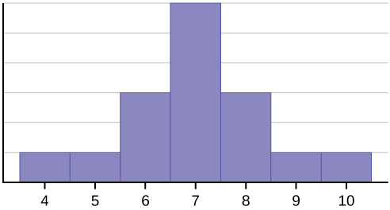
Skew and Symmetry in a Statistical Histogram in relation to the measure of central tendency
Consider the following data set. 4; 5; 6; 6; 6; 7; 7; 7; 7; 7; 7; 8; 8; 8; 9; 10
Mean = 112/16 = 7
Mode = 7
Median = 7
Mean = Median
Left skewed histogram
Notes:
Start from 2 to 12 add examples

Slide 17
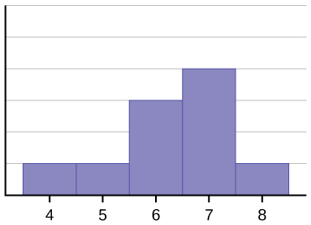
Skew and Symmetry in a Statistical Histogram in relation to the measure of central tendency
The histogram for the data: 4; 5; 6; 6; 6; 7; 7; 7; 7; 8
Mean = 63/10 = 6.3
Mode = 7
Median = 6.5
Mean < Median
Left skewed histogram

Slide 18
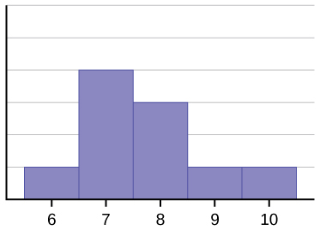
Skew and Symmetry in a Statistical Histogram in relation to the measure of central tendency
The histogram for the data: 6; 7; 7; 7; 7; 8; 8; 8; 9; 10
Mean = 68/10 = 6.8
Mode = 7
Median = 11.5
Median < Mean
Right skewed histogram

Slide 19
Skew and Symmetry in a Statistical Histogram in relation to the measure of central tendency
It is recommended to use median instead of mean. Why?
Mean is more sensitive to outliers and can be significantly deviated.

Slide 20
Measure of central tendency
Import numpy as np
Mean
np.mean(b)
Median
np.median(b)
Mode
statistics.mode(b)
Notes:
Numpy array. 3 day numpy and pandas

Slide 21
Types of statistics in data science

Slide 22
Measure of spread (variability)
A measure of spread, sometimes also called a measure of dispersion, is used to describe the variability in a sample or population. It is usually used in conjunction with a measure of central tendency, such as the mean or median, to provide an overall description of a set of data

Slide 23
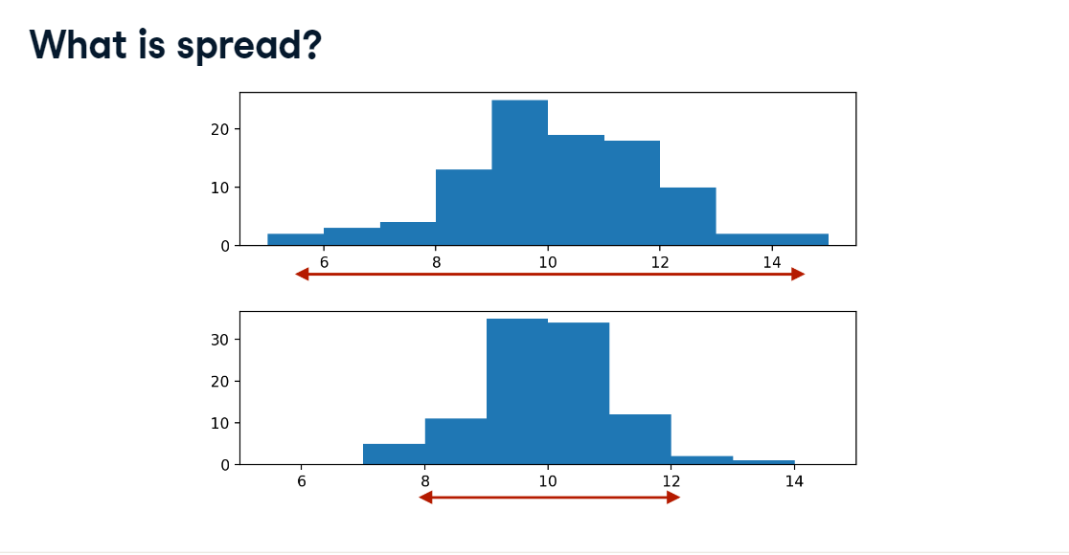
Measure of spread (variability)
Note: that spread is how far or close the points from the mean are, compared to each other.

Slide 24
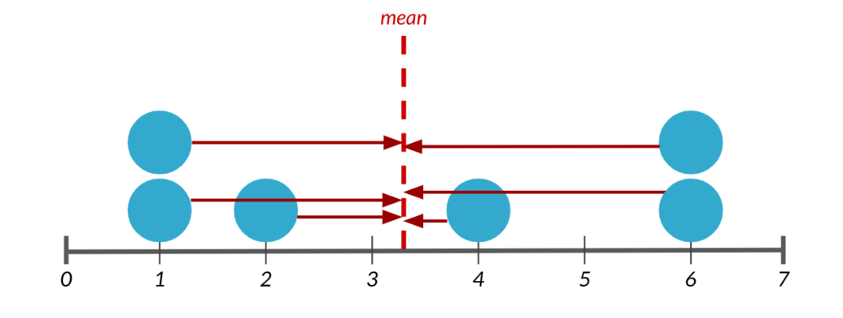
Measure of spread (variability)
1. Variance
Average distance from each data point to the data’s mean

Slide 25
Measure of spread (variability)
How to calculate variance: The differences between each number in the data set and the mean, then squaring the differences to make them positive, and finally dividing the sum of the squares by the number of values in the data set.

Slide 26
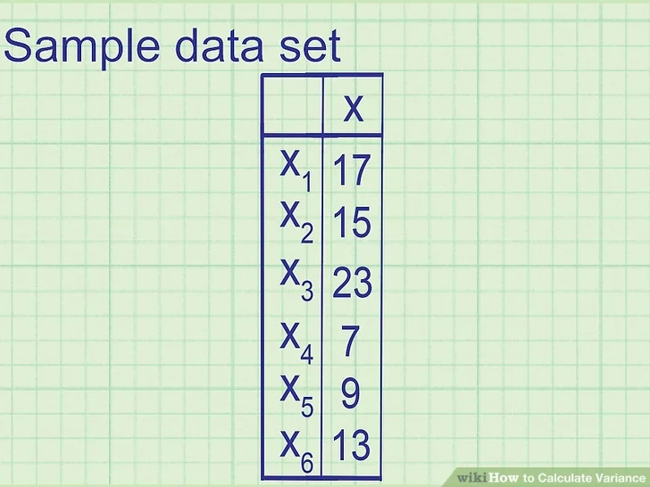
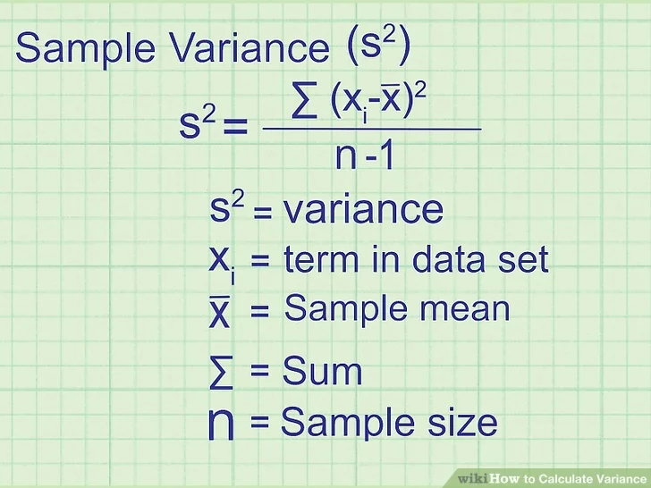
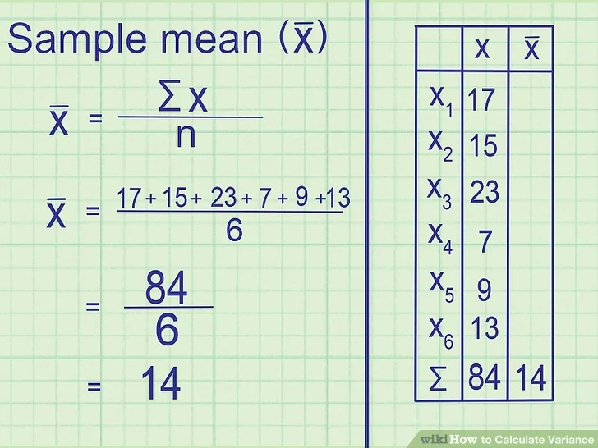
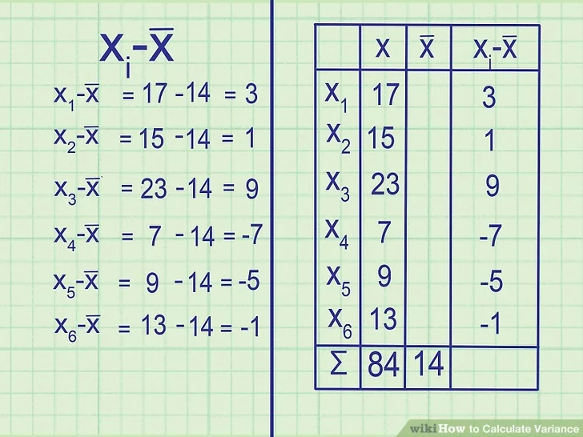
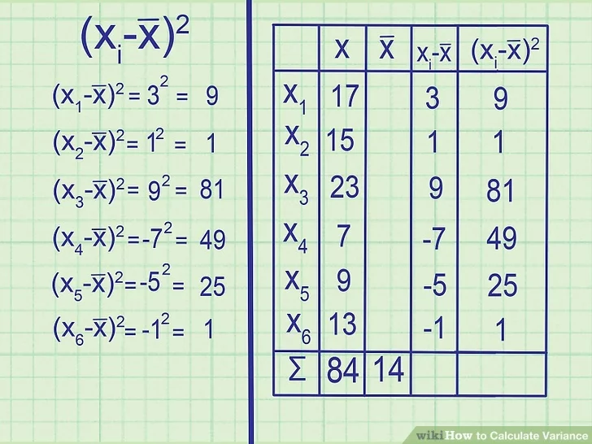
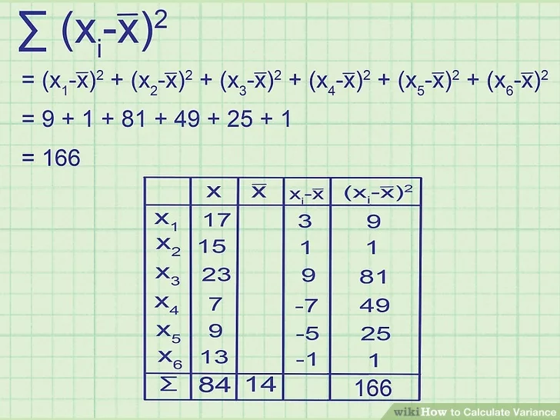
How to calculate variance

Slide 27
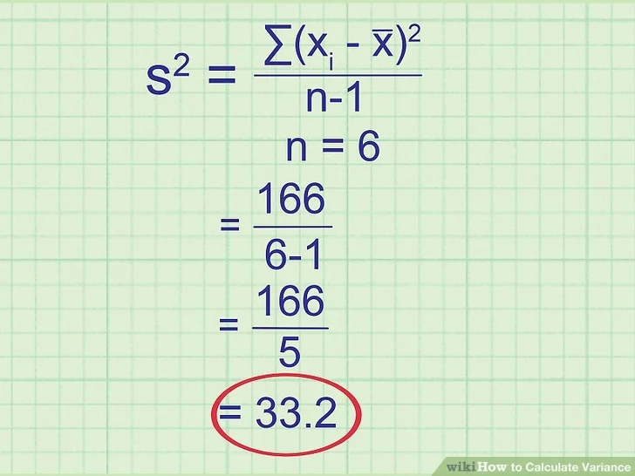
How to calculate variance

Slide 28
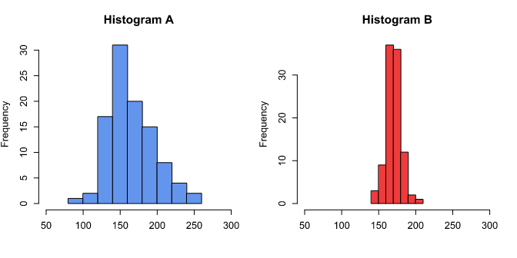
What does variance indicate?
The higher the variance the more spread is the data.
Comparing the above histograms, note that the variance of the data in
Histogram A is 907.947, compared with the variance of the data in Histogram B, which is 106.5411.

Slide 29
Measure of spread (variability)
Variance
np.var(b, axis=None, dtype=None)

Slide 30

Measure of spread (variability)
1. Standard Deviation
A standard deviation (or σ) :
measure of how dispersed the data is in relation to the mean.
It is the square root of the variance
Low standard deviation means data are clustered around the mean, and high standard deviation indicates data are more spread out.

Slide 31
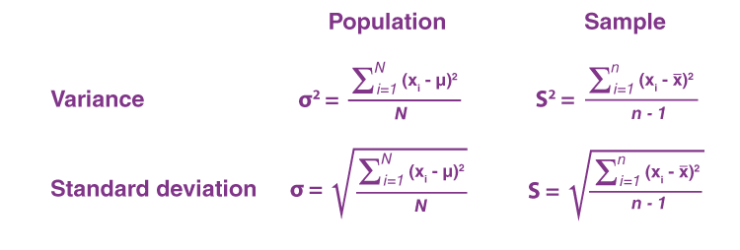
Variance vs. standard deviation

Slide 32
Variance vs. standard deviation
To use the population (variance or standard deviation) you need all of the data available whereas to use the sample (variance or standard deviation) you only need a proportion of it.

Slide 33
Variance vs. standard deviation
Suppose a sample standard deviation was calculated to be 8. Then what would be the associated variance? → 64
Suppose a sample variance was calculated to be 144. Then what would be the associated standard deviation? → 12

Slide 34
Measure of spread (variability)
Standard Deviation
np.std(b, axis=None, dtype=None)

Slide 35
Measure of spread (variability)
Correlation
Correlation is a statistical measure that expresses the extent to which two variables are linearly related (meaning they change together at a constant rate).
Corrleation is a common tool for describing simple relationships without making a statement about cause and effect

Slide 36
Measure of spread (variability)
Correlation
Correlation coefficients are used to measure the strength of the linear relationship between two variables.
A correlation coefficient greater than zero indicates a positive relationship while a value less than zero signifies a negative relationship.
A value of zero indicates no relationship between the two variables being compared.
When interpreting correlation, it's important to remember that just because two variables are correlated, it does not mean that one causes the other

Slide 37
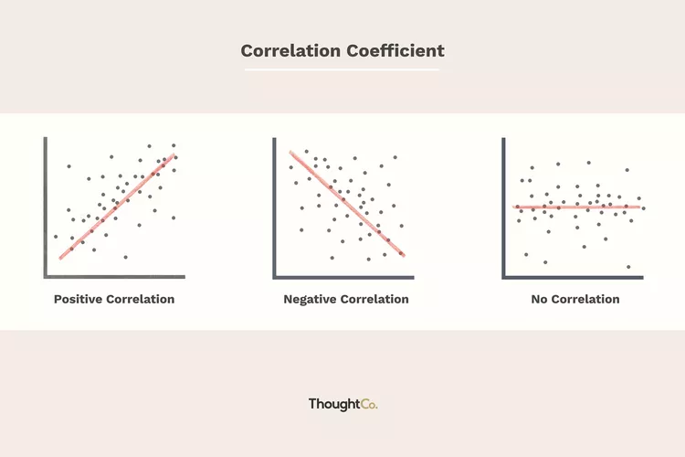
Measure of spread (variability) Correlation
+1
-1
Zero 0
The relationship between oil prices and airfares
Rain level
Studying duration and performance
Height above sea level and temperature.
As you climb the mountain (increase in height)
it gets colder (decrease in temperature).
No relationship between
the amount of coffee drunk
and level of intelligence

Slide 38
Introduction to google colab

Slide 39
Google colab tutorial for data scientists
What is Google Colab?
Google Colab is a cloud-based Jupyter notebook environment from Google Research.
It is a simple and easy-to-use interface.
The best way to understand something is to try it yourself

Slide 40
Why google colab?
It helps you get started with your data science journey with almost no setup
No need for configuring your environment.
Comes with some of the most popular Python data science libraries pre-installed.
Easy sharing and collaboration
Working with data from various sources
Automatic storage and version control

Slide 41
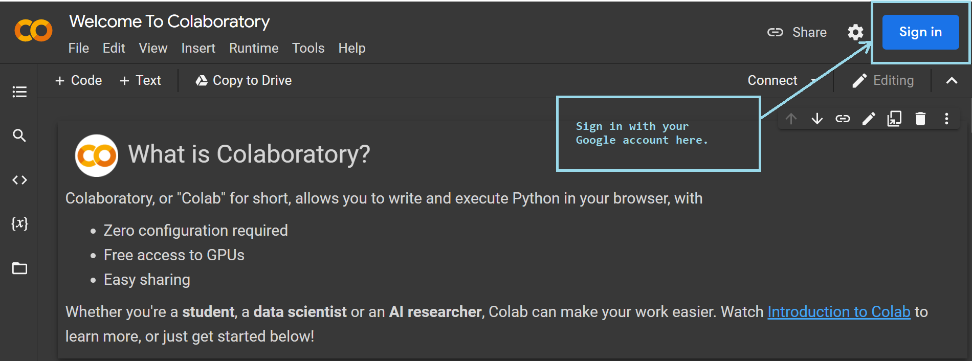
Google colab features
colab.research.google.com
Sign in
Write and run your code

Slide 42
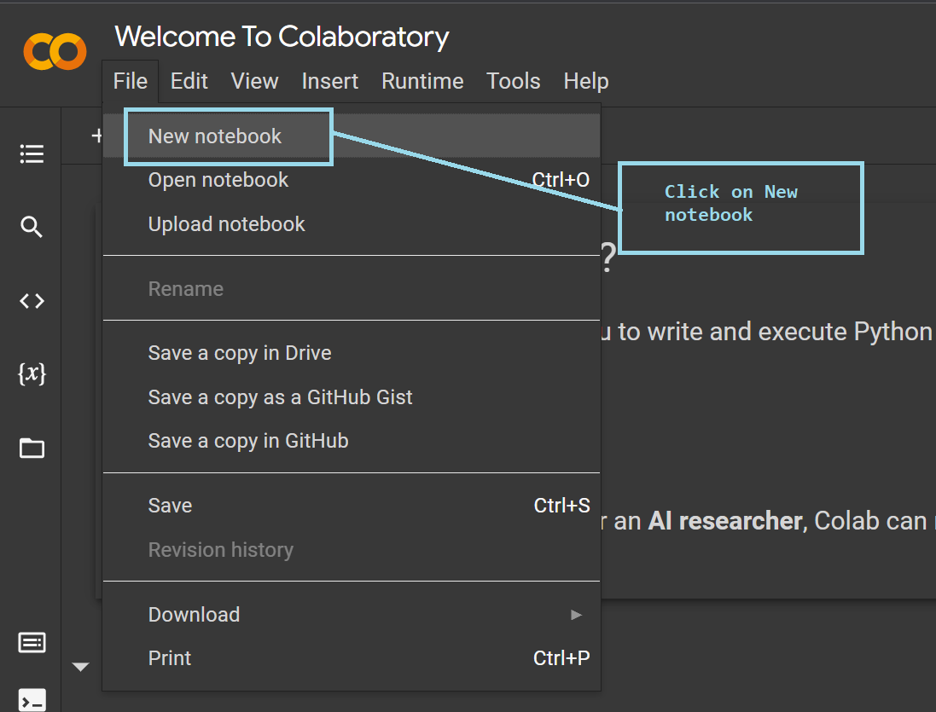
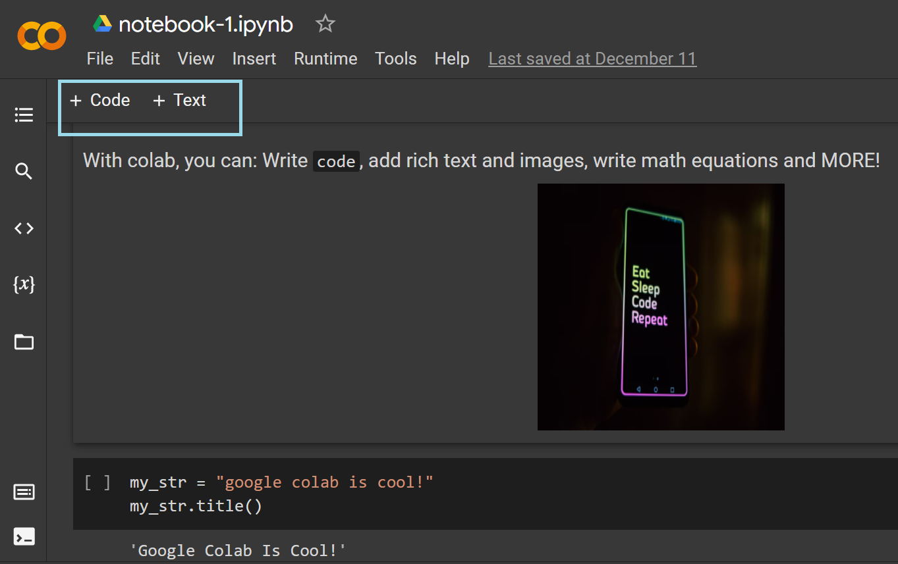
Google colab features
'File' → 'New notebook → +code → Run

Slide 43

Google colab features
Easy sharing and collaboration

Slide 44
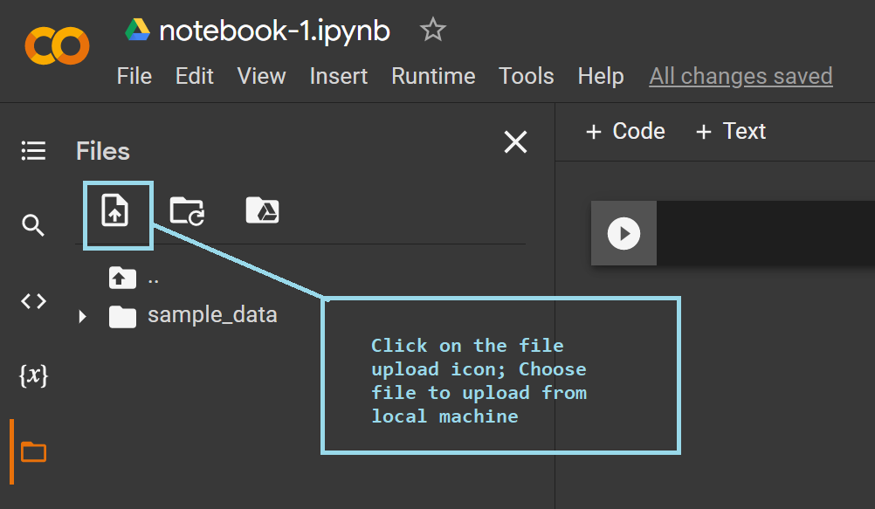
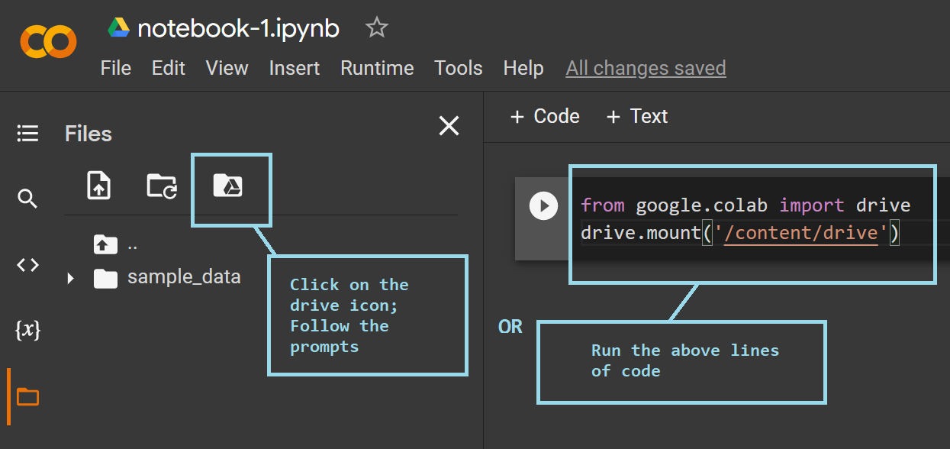
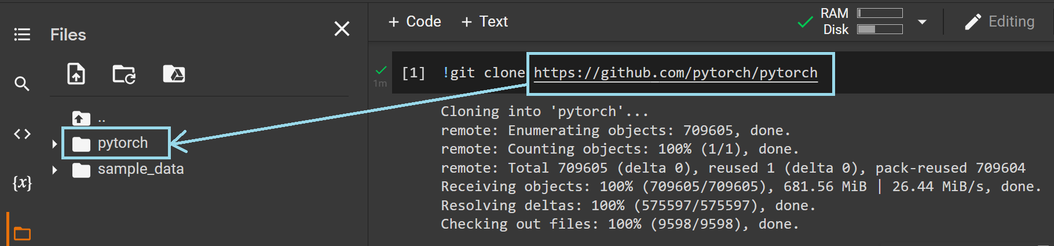
Google colab features
Working with data from various sources
Loading data from your local machine
Mounting Google drive to Colab instance
Cloning a GitHub repo into Colab instance

Slide 45
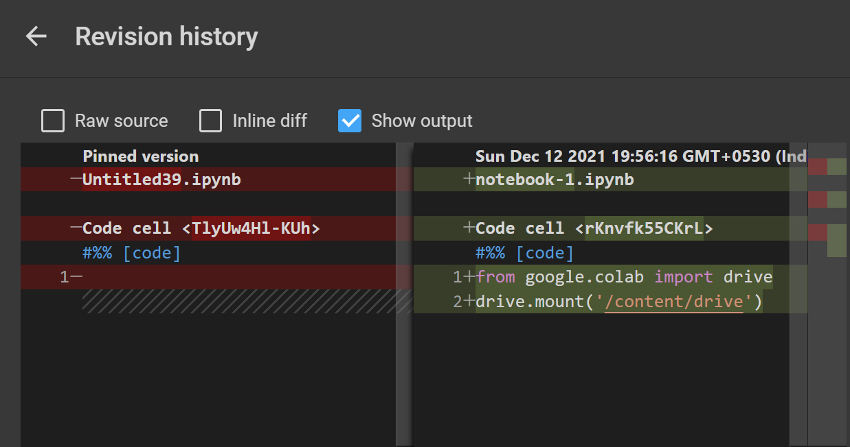
Google colab features
Automatic storage and version control

Slide 46
Introduction to Numpy

Slide 47
What is Numpy?
Numpy (stands for numerical python)
It is a python library used for dealing with arrays.
Numpy have mathematical functions
It is an open source project
Notes:
An open source can be used without fees and can add into it

Slide 48
Why Numpy is important?
You want to understand the data on hand. Visualize it, and try to understand hidden patterns. In later stages you will be able build algorithms based on your understanding.
In short numpy and statistics help you to describe the data.

Slide 49
Important terms to understand
Array
Table of elements. Elements should be of the same type.
Rank
Number of dimensions of the array as called.
Shape
A tuple of integers gives the size of the array (1,5)
Any array class in Numpy is called as ndarray

Slide 50
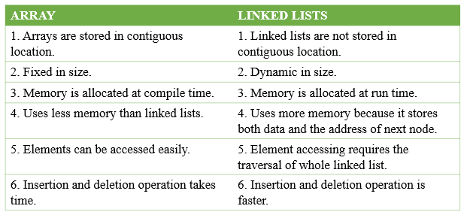
Important terms to understand
Why numpy arrays are faster than list?

